Slide 1
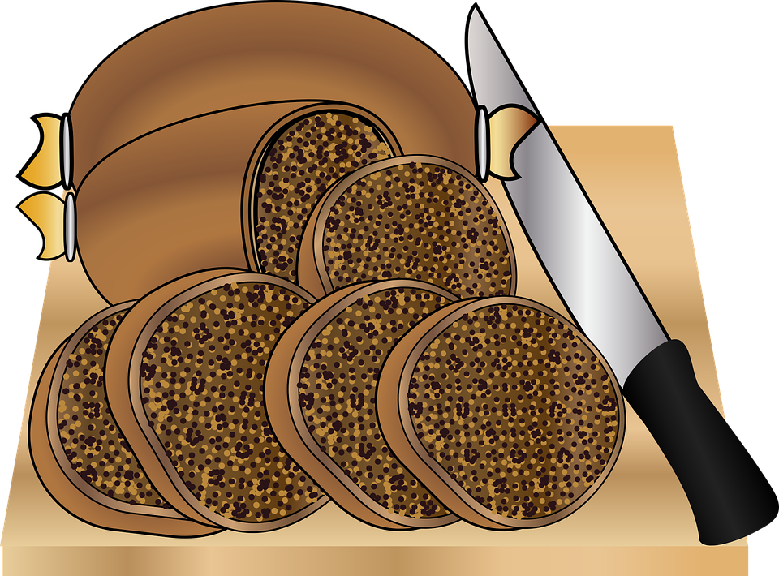
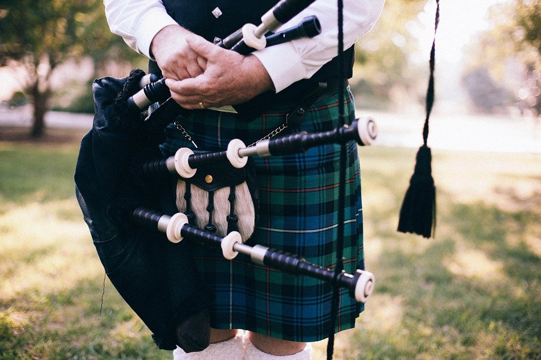
Burns Night
What is Burns Night?
Credit: Nina Garman (pixabay.com)
Credit: PublicDomainArchive (pixabay.com)
https://www.itv.com/news/border/topic/burns-night/
Notes:
Whether it’s getting presents, eating lots of lovely food, or simply being off school, for many of us the end of the year is a time filled with happiness and excitement.
However, then we get to January – we have to get up on the still cold, dark, mornings, come to school, think about all the homework we have or haven’t done, and often don’t have something to look forward to like we did before the holidays.

Slide 2
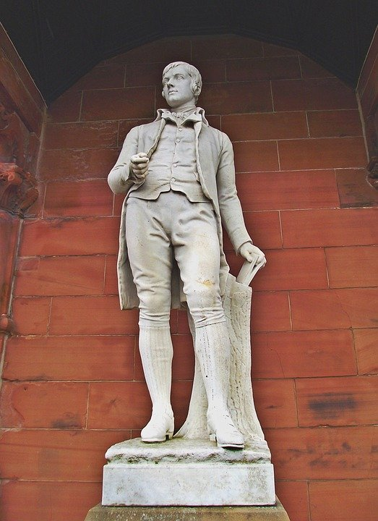
Burns Night celebrates the life of the Scottish poet, Robert Burns, who was born on January 25 1759.
On this day, every year, many people across Scotland and the rest of the UK organise a ‘Burns Supper’, where people read Burns’ poetry, give toasts, and traditionally eat haggis (a type of sausage prepared in a sheep’s stomach – though vegetarian and vegan versions are now available!)
Credit: David Tollmie (pixabay.com)
Notes:
Whether it’s getting presents, eating lots of lovely food, or simply being off school, for many of us the end of the year is a time filled with happiness and excitement.
However, then we get to January – we have to get up on the still cold, dark, mornings, come to school, think about all the homework we have or haven’t done, and often don’t have something to look forward to like we did before the holidays.

Slide 3
We are now going to watch an ITV clip of an animated Robert Burns reading one of his poems, ‘To a Mouse’.
As we watch, try and work out what the poem is about, and why he might have written it!
Hint: if you can’t work out what he’s saying (it was written a very long time ago!), why do you think he might have written a poem addressed to a mouse!?
Credit: David Tollmie (pixabay.com)
https://bit.ly/38cDRpA
Notes:
Whether it’s getting presents, eating lots of lovely food, or simply being off school, for many of us the end of the year is a time filled with happiness and excitement.
However, then we get to January – we have to get up on the still cold, dark, mornings, come to school, think about all the homework we have or haven’t done, and often don’t have something to look forward to like we did before the holidays.

Slide 4
What do you think the poem, ‘To a Mouse’, is about?
The poem is from the perspective of a farmer who accidentally destroys a mouse’s home whilst ploughing a field. He apologises to the mouse, not just for himself, but for all of mankind for ruining his home.
Credit: David Tollmie (pixabay.com)
https://bit.ly/38cDRpA
Notes:
Whether it’s getting presents, eating lots of lovely food, or simply being off school, for many of us the end of the year is a time filled with happiness and excitement.
However, then we get to January – we have to get up on the still cold, dark, mornings, come to school, think about all the homework we have or haven’t done, and often don’t have something to look forward to like we did before the holidays.

Slide 5
Why do you think Robert Burns has written a poem addressed to a mouse?
It is widely believed that Burns wrote this poem on the spot after he went through this experience himself. However, others believe it can be interpreted in different ways:
Mankind’s destruction of nature
People’s treatment of those they see as being ‘inferior’
Credit: David Tollmie (pixabay.com)
https://bit.ly/38cDRpA
Notes:
Whether it’s getting presents, eating lots of lovely food, or simply being off school, for many of us the end of the year is a time filled with happiness and excitement.
However, then we get to January – we have to get up on the still cold, dark, mornings, come to school, think about all the homework we have or haven’t done, and often don’t have something to look forward to like we did before the holidays.

Slide 6
One of the most famous lines from the poem is ‘The best laid schemes o' Mice an' Men. Gang aft agley’
Or in modern English:
‘The best laid plans of mice and men often go wrong’.
What do you think this means?
Credit: David Tollmie (pixabay.com)
https://bit.ly/38cDRpA
Notes:
Whether it’s getting presents, eating lots of lovely food, or simply being off school, for many of us the end of the year is a time filled with happiness and excitement.
However, then we get to January – we have to get up on the still cold, dark, mornings, come to school, think about all the homework we have or haven’t done, and often don’t have something to look forward to like we did before the holidays.

Slide 7
‘The best laid plans of mice and men often go wrong’.
Even when we plan something very carefully, it doesn’t always go the way we want it to.
How can we respond to this in a positive way?
Credit: David Tollmie (pixabay.com)
https://bit.ly/38cDRpA
Notes:
Whether it’s getting presents, eating lots of lovely food, or simply being off school, for many of us the end of the year is a time filled with happiness and excitement.
However, then we get to January – we have to get up on the still cold, dark, mornings, come to school, think about all the homework we have or haven’t done, and often don’t have something to look forward to like we did before the holidays.

Slide 8
How can we respond to this in a positive way?
Be resilient
Respond to feedback positively
Be reflective
Don’t be afraid to ask other people for help and support
Credit: David Tollmie (pixabay.com)
https://bit.ly/38cDRpA
Notes:
Whether it’s getting presents, eating lots of lovely food, or simply being off school, for many of us the end of the year is a time filled with happiness and excitement.
However, then we get to January – we have to get up on the still cold, dark, mornings, come to school, think about all the homework we have or haven’t done, and often don’t have something to look forward to like we did before the holidays.

Slide 9
For further exploration, see…
Resilience: https://www.bbc.co.uk/programmes/p06vkr5p
Suggested activity: after listening to Nequela’s story, hold a discussion in which pupils can reflect on how they can become more resilient both in and outside of school
Be creative:
Suggested activity: pupils should write there own poem to give a message about something that they themselves feel passionate about.
Credit: David Tollmie (pixabay.com)

