Slide 1
LGBT History Month
LGBT History Month
LGBT History Month
What does LGBT stand for?
Credit: MMI9 (pixabay.com)
Notes:
Whether it’s getting presents, eating lots of lovely food, or simply being off school, for many of us the end of the year is a time filled with happiness and excitement.
However, then we get to January – we have to get up on the still cold, dark, mornings, come to school, think about all the homework we have or haven’t done, and often don’t have something to look forward to like we did before the holidays.

Slide 2
LGBT History Month
LGBT stands for Lesbian, Gay, Bisexual and Transgender, but the movement represents many different people, meaning it is often referred to as LGBT+
Credit: MMI9 (pixabay.com)
Notes:
Whether it’s getting presents, eating lots of lovely food, or simply being off school, for many of us the end of the year is a time filled with happiness and excitement.
However, then we get to January – we have to get up on the still cold, dark, mornings, come to school, think about all the homework we have or haven’t done, and often don’t have something to look forward to like we did before the holidays.

Slide 3
The rainbow flag has become synonymous with the LGBT+ movement, but where does it come from?
We are going to watch a BBC programme that explains the flag’s history.
As we watch, think about why people campaign for their rights and why it is important.
Credit: JaneB13 (pixabay.com)
https://www.bbc.co.uk/programmes/p06dh1rg
Notes:
Whether it’s getting presents, eating lots of lovely food, or simply being off school, for many of us the end of the year is a time filled with happiness and excitement.
However, then we get to January – we have to get up on the still cold, dark, mornings, come to school, think about all the homework we have or haven’t done, and often don’t have something to look forward to like we did before the holidays.

Slide 4
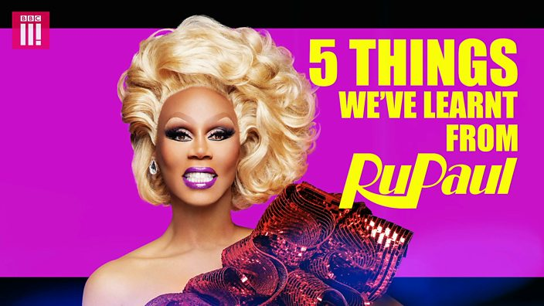
Ru Paul’s Drag Race has been described as not just a TV show, but as a ‘movement’.
Here, Ru shares five important things that we can all learn from, regardless of how we identify.
As we watch, decide which of Ru’s five messages you believe is most important to you.
Credit: BBC Three (OG:image)
https://www.bbc.co.uk/bbcthree/clip/329cb490-3b61-4ea2-ad77-fac0ad46995e
Notes:
Whether it’s getting presents, eating lots of lovely food, or simply being off school, for many of us the end of the year is a time filled with happiness and excitement.
However, then we get to January – we have to get up on the still cold, dark, mornings, come to school, think about all the homework we have or haven’t done, and often don’t have something to look forward to like we did before the holidays.

Slide 5
Which of Ru Paul’s messages do you think is most important?
Why?
Credit: BBC Three (OG:image)
https://www.bbc.co.uk/bbcthree/clip/329cb490-3b61-4ea2-ad77-fac0ad46995e
Notes:
Whether it’s getting presents, eating lots of lovely food, or simply being off school, for many of us the end of the year is a time filled with happiness and excitement.
However, then we get to January – we have to get up on the still cold, dark, mornings, come to school, think about all the homework we have or haven’t done, and often don’t have something to look forward to like we did before the holidays.

Slide 6
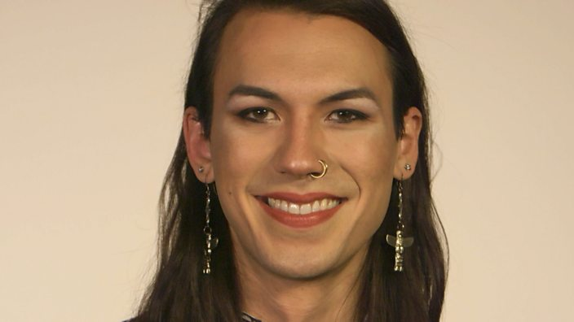
PSHE: Further suggested activities
Watch the BBC Three clip ‘Coming Out: Understood’
Class discussion: why is it important that we all strive to understand each other?
Credit: BBC Three (OG:image)
https://www.bbc.co.uk/bbcthree/clip/87c6c18a-6b42-4618-879f-7cfee5bc4083
Notes:
Whether it’s getting presents, eating lots of lovely food, or simply being off school, for many of us the end of the year is a time filled with happiness and excitement.
However, then we get to January – we have to get up on the still cold, dark, mornings, come to school, think about all the homework we have or haven’t done, and often don’t have something to look forward to like we did before the holidays.

Slide 7
