Slide 1
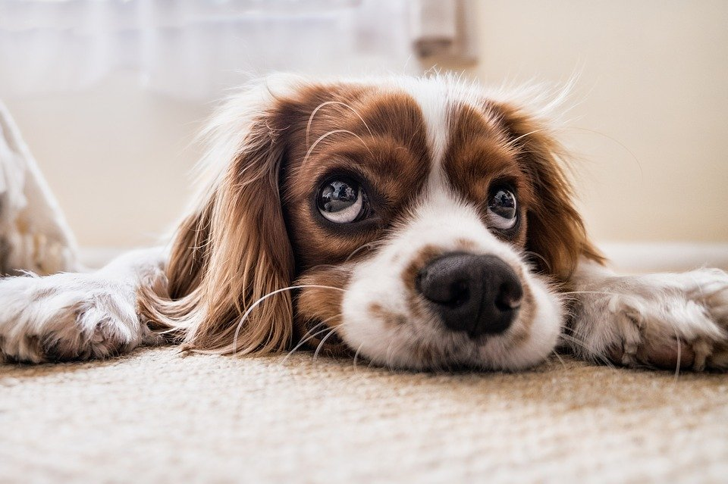
The ‘January Blues’
What are the ‘January Blues’?
Credit: Fran_ (Pixabay.com)
Notes:
Whether it’s getting presents, eating lots of lovely food, or simply being off school, for many of us the end of the year is a time filled with happiness and excitement.
However, then we get to January – we have to get up on the still cold, dark, mornings, come to school, think about all the homework we have or haven’t done, and often don’t have something to look forward to like we did before the holidays.

Slide 2
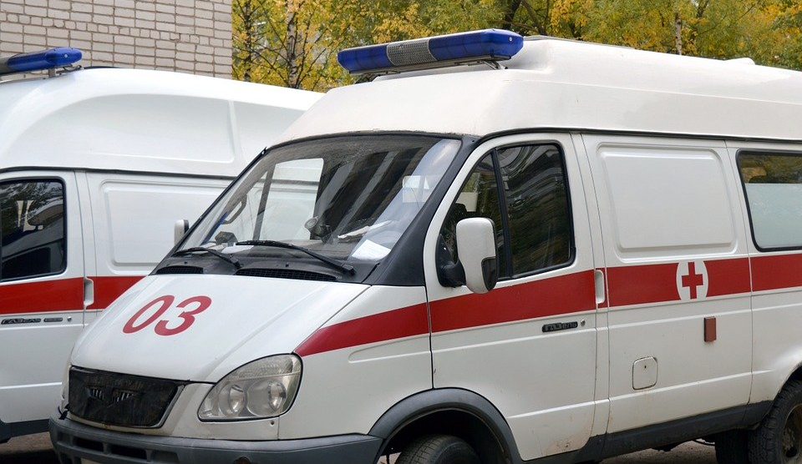
We are now going to watch a clip from a BBC ONE programme, Ambulance.
As we watch, think about what reasons do Nat and Nat give for feeling the ‘January Blues’?
Challenge: What reasons might people your age have for feeling low in January?
Credit: Alina Kuptsova (Pixabay.com)
https://www.bbc.co.uk/programmes/p06573dz
Notes:
We are now going to watch a clip from a BBC ONE programme, Ambulance, where paramedics, Nat and Nat, discuss being back at work after Christmas.

Slide 3
What reasons did Nat and Nat give for why people might experience the January blues?
It’s still winter (cold and horrible weather)
Christmas and New Year celebrations are over
You don’t have much money
You are back at work
Credit: Alina Kuptsova (Pixabay.com)
https://www.bbc.co.uk/programmes/p06573dz

Slide 4
What are some of the reasons people your age might feel low in their mood in January?
You can’t play with your new gifts
You are back at school
You have to hand in all your holiday homework
You can’t choose how you spend your time
… and sometimes we might not have a particular reason– we just feel a bit rubbish!
Credit: Alina Kuptsova (Pixabay.com)
https://www.bbc.co.uk/programmes/p06573dz

Slide 5
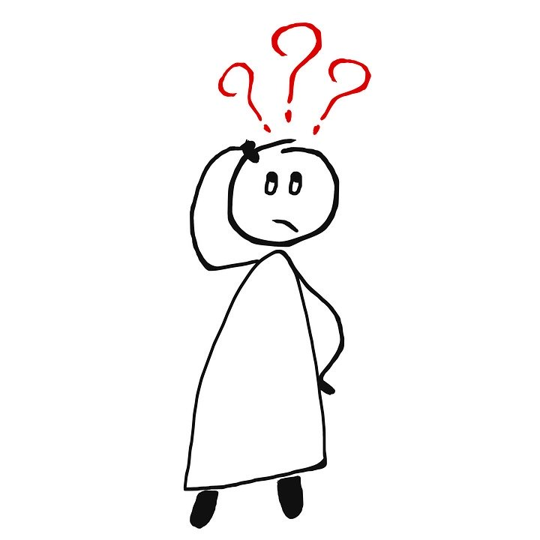
However, Nat did say something that made her happy in January – it’s her daughter’s birthday!
So, what can WE do to make sure we survive the January blues?
Credit: ElisaRiva (pixabay.com)

Slide 6
Spend time with friends and family
Keep active with sports or exercise
Make time for hobbies and activities you enjoy doing
… and If you still feel low, that’s okay! Talk to an adult (your parents, a teacher) you trust!
Credit: ElisaRiva (pixabay.com)

Slide 7
For further exploration…
Seasonal affective disorder:
https://www.itv.com/thismorning/health/do-the-winter-blues-really-exist
Suggested activity: pupils can complete a mood diary based on their last week as a way to reflect on how they are feeling. Encourage them to continue this throughout January (and beyond).
How to handle your finances :
https://www.bbc.co.uk/programmes/p04qrnp5
https://www.bbc.co.uk/bbcthree/clip/75f8c611-664e-497b-a411-e11e67ea5de7
Suggested activity: pupils should choose three financial goals that they have for 2020, and explain why they have chosen this goal. These goals should be SMART (specific, measurable, achievable, relevant, and time-bound).
Credit: ElisaRiva (pixabay.com)

