Slide 1
Careers Week - Entrepreneurship
If there is one existing product in the world that YOU could have invented, what would it be and why?
Credit: Peggy_Marco (pixabay.com)

Slide 2
What is an entrepreneur?
An entrepreneur is someone who sets up a business, particularly when they see potential in new opportunities.
Credit: Gerd Altman (pixabay.com)

Slide 3
Dragon’s Den
We are now going to watch a clip from Dragon’s Den, where Sam pitches his idea to try and get successful business people (the Dragons) to invest (give money) in their idea.
Credit: BBC Two (og:image)
https://www.bbc.co.uk/programmes/p06h43nc

Slide 4
Dragon’s Den
What was good about Sam’s pitch?
Is there anything he could have done to make it even better?
Credit: BBC Two (og:image)
https://www.bbc.co.uk/programmes/p06h43nc

Slide 5
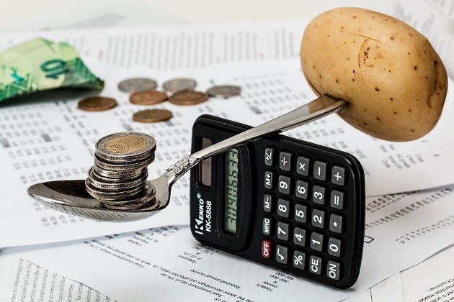
Dragon’s Den – competition time!
Design a sustainable product
Take a household item and come up with a new use for it
Create a school resource which is revolutionary to learning
Credit: Steve Buissinne (pixabay.com)
Credit: Free-Photos (pixabay.com)

Slide 6
Dragon’s Den – competition time! What do you need to do?
Come up with an idea
Prepare your pitch
Pitch it to ‘The Dragons’
See if you can persuade them to invest in your idea
If you get your investment, you will have a chance of winning our Dragon’s Den Competition, which will be decided by your fellow students!
Credit: Clker-Free-Vector-Images (pixabay.com)

Slide 7
Dragon’s Den – competition time!
Get inventing, and good luck! Teachers, remember to tweet us @ERAresources and let us know some of the inventive ideas your pupils come up with!
Credit: Clker-Free-Vector-Images (pixabay.com)

