Slide 1
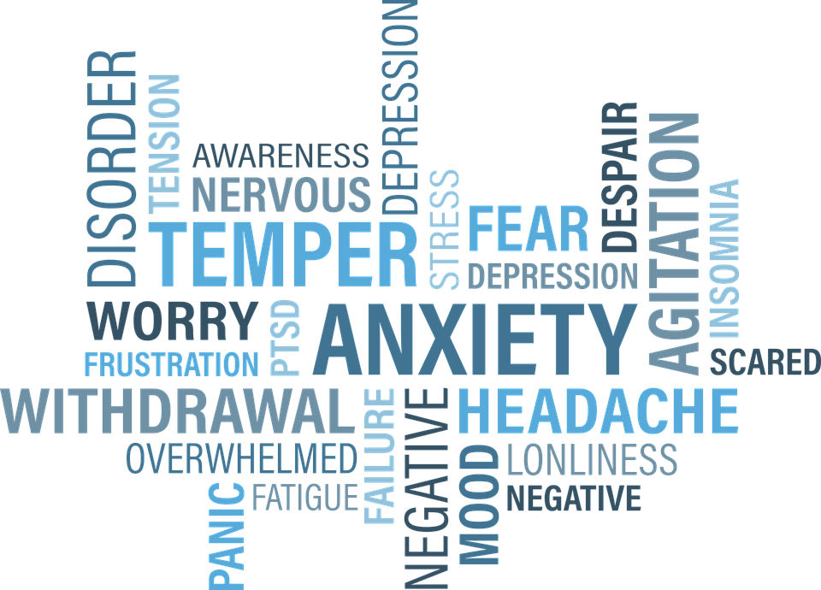
Eating Disorders Awareness Week
What is an eating disorder?
Credit: 905513 (pixbay.com)
https://www.bbc.co.uk/programmes/p04s9v03
Notes:
Whether it’s getting presents, eating lots of lovely food, or simply being off school, for many of us the end of the year is a time filled with happiness and excitement.
However, then we get to January – we have to get up on the still cold, dark, mornings, come to school, think about all the homework we have or haven’t done, and often don’t have something to look forward to like we did before the holidays.

Slide 2
An eating disorder is when you have an unhealthy attitude to food, which can take over your life and make you ill.
It can involve eating too much or too little, or becoming obsessed with your weight and body shape.
But there are treatments that can help and you can recover from an eating disorder.
- NHS.org.uk
Credit: 905513 (pixbay.com)
https://www.bbc.co.uk/programmes/p04s9v03
Notes:
Whether it’s getting presents, eating lots of lovely food, or simply being off school, for many of us the end of the year is a time filled with happiness and excitement.
However, then we get to January – we have to get up on the still cold, dark, mornings, come to school, think about all the homework we have or haven’t done, and often don’t have something to look forward to like we did before the holidays.

Slide 3
We are going to watch a clip from a BBC Two programme, ‘Trust me, I’m a doctor’.
As we watch, think about whether there is anything you see that shocks or surprises you.
Credit: 905513 (pixbay.com)
https://www.bbc.co.uk/programmes/p04s9v03
Notes:
Whether it’s getting presents, eating lots of lovely food, or simply being off school, for many of us the end of the year is a time filled with happiness and excitement.
However, then we get to January – we have to get up on the still cold, dark, mornings, come to school, think about all the homework we have or haven’t done, and often don’t have something to look forward to like we did before the holidays.

Slide 4
What are some of the signs that you or someone you know if suffering from an eating disorder?
Talking about weight and body shape a lot
Preoccupation with thoughts of food
Obsessive behaviour
Exercising an excessive amount
Shutting yourself off from the world
Secrecy
Mood swings
Feeling anxious and tense
Depression, low self-esteem
Feeling overly tired
Credit: 905513 (pixbay.com)
https://www.bbc.co.uk/programmes/p04s9v03
Notes:
Whether it’s getting presents, eating lots of lovely food, or simply being off school, for many of us the end of the year is a time filled with happiness and excitement.
However, then we get to January – we have to get up on the still cold, dark, mornings, come to school, think about all the homework we have or haven’t done, and often don’t have something to look forward to like we did before the holidays.

Slide 5
If you are worried that you, or someone you know, might be suffering from an eating disorder, talk to an adult you trust.
Credit: 905513 (pixbay.com)
https://www.bbc.co.uk/programmes/p04s9v03
Notes:
Whether it’s getting presents, eating lots of lovely food, or simply being off school, for many of us the end of the year is a time filled with happiness and excitement.
However, then we get to January – we have to get up on the still cold, dark, mornings, come to school, think about all the homework we have or haven’t done, and often don’t have something to look forward to like we did before the holidays.

Slide 6
PSHE Resources
Here is a full 40 mins lesson on Eating Disorders and Body Image
Warning: contains some strong language, so not suitable for younger age groups.
Credit: 905513 (pixbay.com)
https://www.bbc.co.uk/programmes/p04s9v03
Notes:
Whether it’s getting presents, eating lots of lovely food, or simply being off school, for many of us the end of the year is a time filled with happiness and excitement.
However, then we get to January – we have to get up on the still cold, dark, mornings, come to school, think about all the homework we have or haven’t done, and often don’t have something to look forward to like we did before the holidays.

Slide 7
Learning Objective:
To use broadcast media to understand eating disorders.
Starter
What is an eating disorder?
Challenge:
Why do people suffer from eating disorders?
Useful Vocab
Disorder: a state of disruption

Slide 8
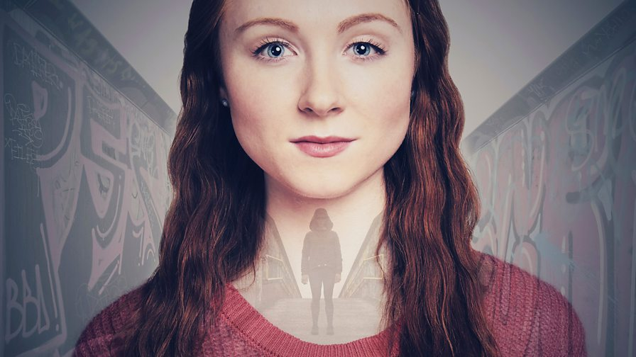
We are going to watch some clips from an online series, Overshadowed, about a girl called Imogen who decides to document her life with her new camera.
Credit: BBC Three (OG:image)
Remember, when watching something personal and of a sensitive nature, we must always be respectful of others people’s thoughts, feelings, and experiences
Why is this so important?

Slide 9
Clip 1 – 00:00-1:00
Imogen’s is experiencing a lot of things that many of us can relate to:
She feels like she must be weird because she’s never had a boyfriend.
She is not happy about the way she looks
She wants to get in shape to look and feel better – her mum talks about her own dieting quite a lot
Her parents split up last year
Credit: BBC Three (OG:image)
https://www.bbc.co.uk/iplayer/episode/p05h5vn4/overshadowed-series-1-episode-1
Task: As we watch, write down adjectives and phrases you would use to describe Imogen.
Be prepared to explain why you have chosen them.

Slide 10
Clip 2 – 6:55-7:57
Imogen has started running to try and get fit and is being careful about what she eats. She and her sister are shopping for outfits for her sister’s birthday.
Task: as we watch the next part of the clip, answer the following questions:
How has Imogen’s attitude changed?
Do you think Imogen’s ‘friend’ in the video is being supportive? Why? Why not?
What would you say to your friend if they felt this way about themselves?
Credit: BBC Three (OG:image)
https://www.bbc.co.uk/iplayer/episode/p05h5vn4/overshadowed-series-1-episode-1

Slide 11
Clip 3 – 7:58-8:33
At this point, Imogen has gone out for her sister’s birthday. They are at a Chinese restaurant, but Imogen says she does not like the food. She is now in the toilets recording her video. Her ‘friend’ has appeared.
Credit: BBC Three (OG:image)
Task: as we watch the next clip, answer the following questions:
What do you notice about the way Imogen’s ‘friend’ speaks to her?
Would you speak to your friends that way? Why?
https://www.bbc.co.uk/iplayer/episode/p05h5vn4/overshadowed-series-1-episode-1

Slide 12
Clip 4 – 8:35-11:50
By this point, Imogen has become isolated from her friends and family because her illness has taken over her. Although she was very reluctant, she is now at a clinic getting the help she needs.
Task: What adjectives and phrases would you use to describe Imogen now?
What do you think Imogen’s ‘friend’ represents?
Credit: BBC Three (OG:image)
https://www.bbc.co.uk/iplayer/episode/p05h5vn4/overshadowed-series-1-episode-1
Imogen has a long battle ahead of her, but she has accepted the help she needs, and like Eva O’Connor, the writer of this programme, she will recover.

Slide 13
Class discussion:
‘Sometimes we are horrible to ourselves – we treat ourselves in a way that we would never treat our friends or the people we love’.
What are your views on this statement?
Write down your ideas on your ‘Class Discussion Planning Sheet’ so that you are prepared to share your thoughts and feelings with the class.
Credit: BBC Three (OG:image)

