Slide 1
British Science Week
Why does science matter?
Credit: Kidaha (Pixabay.com)

Slide 2
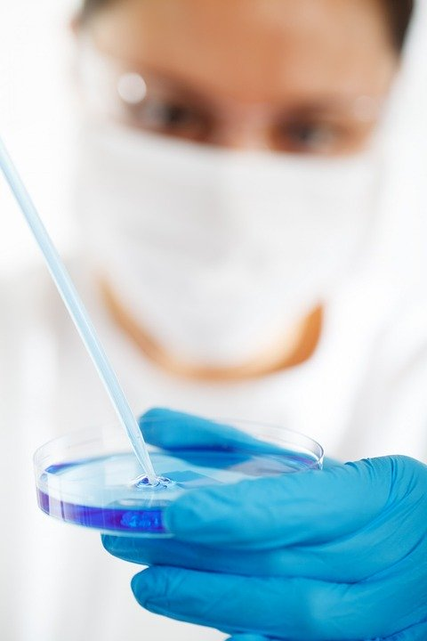
British Science Week
There are many reasons why science are important, including…
It helps us understand the world around us
It helps us develop new technologies
It helps us make medical advances
Credit: PublicDomainPicutres (Pixabay.com)

Slide 3
British Science Week
You might have heard a lot about coronavirus recently, or Covid-19. Currently, scientists and doctors are working on treatments – for the majority of people, the symptoms are similar to a cold.
Credit: PublicDomainPicutres (Pixabay.com)

Slide 4
British Science Week
However, what exactly is a virus?
We are going to watch BBC News programme, The News Explained, where we will learn a bit more about what viruses are.
As we watch, think about why science is important when talking about viruses.
https://www.bbc.co.uk/iplayer/episode/p081948c/the-news-explained-coronavirus-what-are-viruses

Slide 5
British Science Week
However, what exactly is a virus?
We are going to watch BBC News programme, The News Explained, where we will learn a bit more about what viruses are.
As we watch, think about why science is important when talking about viruses.
https://www.bbc.co.uk/iplayer/episode/p081948c/the-news-explained-coronavirus-what-are-viruses

Slide 6
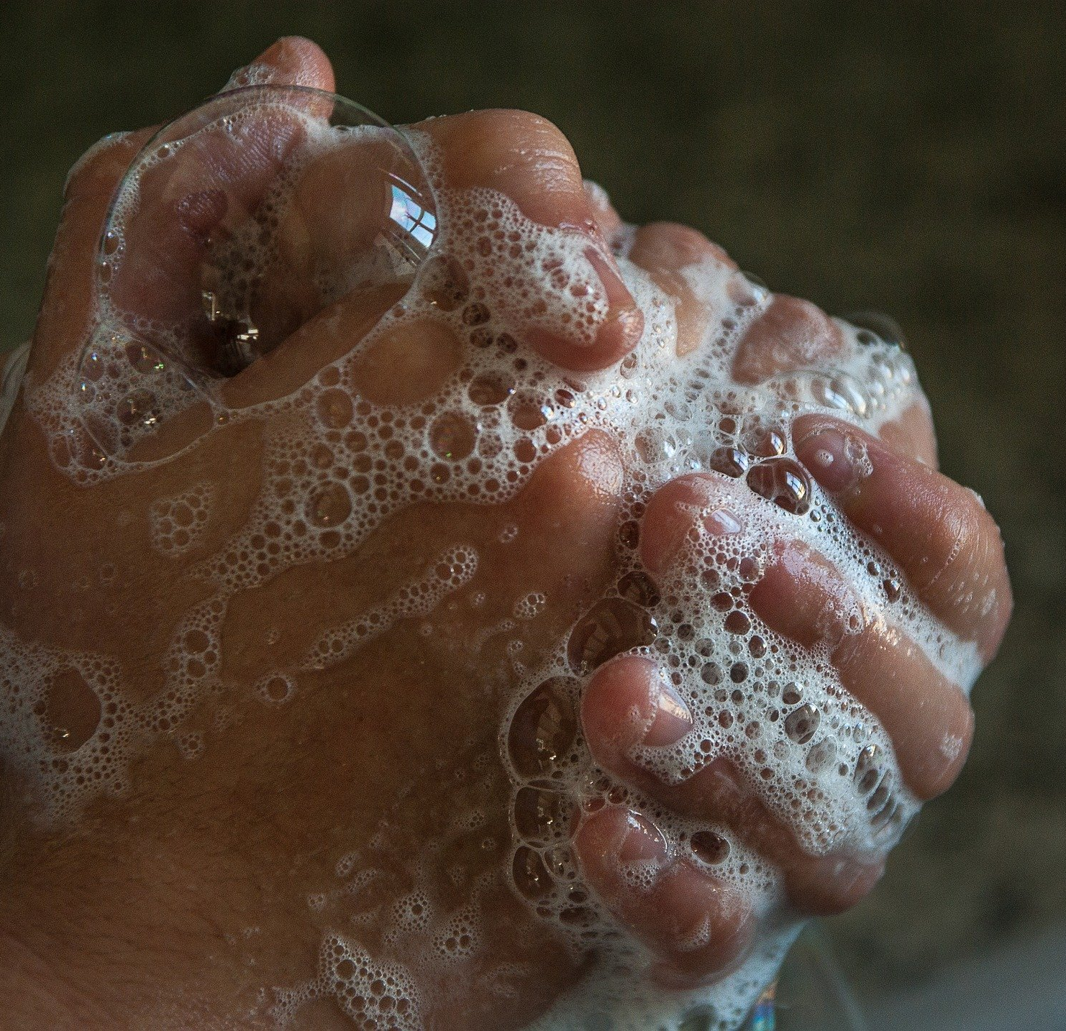
British Science Week
How can we prevent viruses spreading?
Cover your cough or sneeze with a tissue, then throw the tissue in the trash
Clean and disinfect frequently touched objects and surfaces using a regular household cleaning spray or wipe
Wash your hands often and thoroughly with soap and water, especially after going to the toilet, before eating, and after blowing your nose, coughing, or sneezing
If you have any questions, worries, or concerns about anything discussed, talk to an adult you trust!
Credit: jackmac64 (Pixabay.com)

Slide 7
British Science Week
PSHE Ideas:
Class discussion: If you already know you don’t want to be a scientist, should you be made to study science in school?
Print the Discussion Planning Sheet on the next to slide to help pupils prepare for the discussion.
Credit: jackmac64 (Pixabay.com)

Slide 8
