Slide 1
World Book Day – KS4
Match the famous quote to the book and author
‘Maybe you should just press the button’
The Fellowship of the Ring, J.R.R Tolkien
‘Fight ‘til the last gasp’
Henry VI, William Shakespeare
‘You cannot pass!’
Pride and Prejudice, Jane Austen
‘It is better to be feared than loved’
Murder on the Orient Express, Agatha Christie
‘She is tolerable; but not handsome enough to tempt me’
The Maze Runner, James Dashner
‘If you will forgive me for being personal – I do not like your face‘
Alice’s Adventures in Wonderland, Lewis Carol

Slide 2
Match the famous quote to the book and author
‘Maybe you should just press the button’
The Fellowship of the Ring, J.R.R Tolkien
‘Fight ‘til the last gasp’
Henry VI, William Shakespeare
‘You cannot pass!’
Pride and Prejudice, Jane Austen
‘It is better to be feared than loved’
Murder on the Orient Express, Agatha Christie
‘She is tolerable; but not handsome enough to tempt me’
The Maze Runner, James Dashner
‘If you will forgive me for being personal – I do not like your face‘
Alice’s Adventures in Wonderland, Lewis Carol
Notes:
PRINT

Slide 3
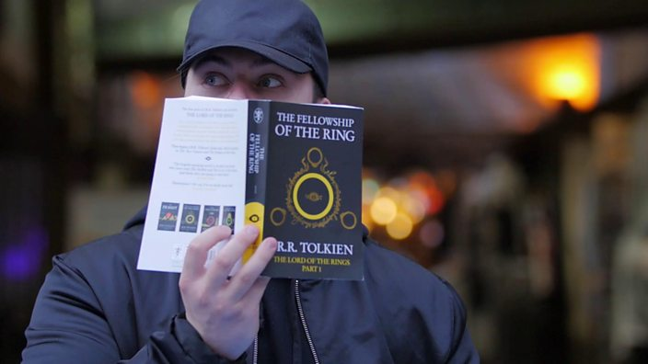
We are now going to watch prankster Jack Jones reading lines from famous books in public.
As we watch, see if your matches were correct!
Credit: og:image (http://ichef.bbci.co.uk/images/ic/704xn/p04dv8l8.jpg)
https://www.bbc.co.uk/bbcthree/clip/d0aac790-400d-45e9-8f58-42f5bf459fad

Slide 4
Match the famous quote to the book and author
‘Maybe you should just press the button’
The Fellowship of the Ring, J.R.R Tolkien
‘Fight ‘til the last gasp’
Henry VI, William Shakespeare
‘You cannot pass!’
Pride and Prejudice, Jane Austen
‘It is better to be feared than loved’
Murder on the Orient Express, Agatha Christie
‘She is tolerable; but not handsome enough to tempt me’
The Maze Runner, James Dashner
‘If you will forgive me for being personal – I do not like your face‘
Alice’s Adventures in Wonderland, Lewis Carol

Slide 5
Based on the quotations, which book would you most like to read and why?
Credit: og:image (http://ichef.bbci.co.uk/images/ic/704xn/p04dv8l8.jpg)
https://www.bbc.co.uk/bbcthree/clip/d0aac790-400d-45e9-8f58-42f5bf459fad

Slide 6
Research
What is each book about?
Credit: og:image (http://ichef.bbci.co.uk/images/ic/704xn/p04dv8l8.jpg)
https://www.bbc.co.uk/bbcthree/clip/d0aac790-400d-45e9-8f58-42f5bf459fad

Slide 7
Class Debate
‘In today’s society, where we have technology, social media, and so much more, reading for pleasure is pointless.’
Use your Debate Planning Sheet to help you
Credit: og:image (http://ichef.bbci.co.uk/images/ic/704xn/p04dv8l8.jpg)
https://www.bbc.co.uk/bbcthree/clip/d0aac790-400d-45e9-8f58-42f5bf459fad

Slide 8
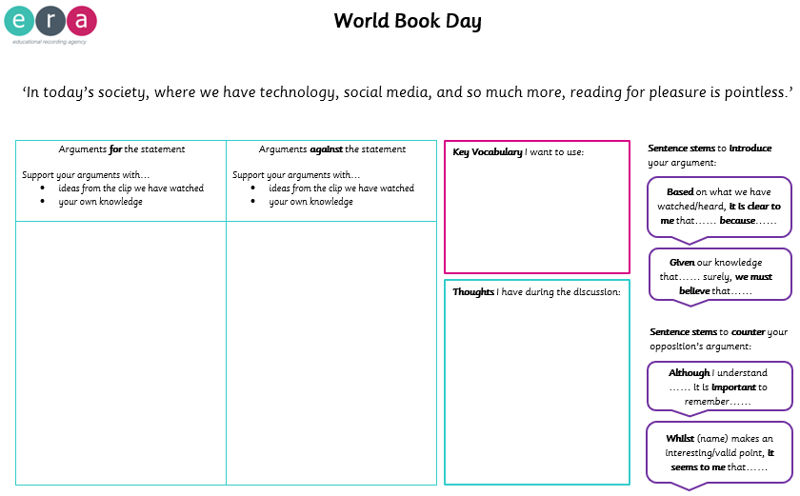
Notes:
PRINT

